Slide 1

QA for an AI-Enabled Threat Intelligence Pipeline
A working prototype: ingestion → normalization → PromptOps → output validation
Notes:
Open by framing this as a quick demo, not a finished product: built in one evening to make the pipeline concrete for myself, and it surfaced a real validation bug along the way -- which is its own QA story.

Slide 2




The Pipeline, Stage by Stage
Ingestion
→
Normalization
→
PromptOps
→
Output Validation
Pull raw telemetry
from source systems
Map fragmented schemas
into one common format
LLM generates a
plain-English narrative
Check accuracy &
faithfulness to source data
Built on NSL-KDD (network intrusion benchmark) — real, trustworthy ground-truth labels
Notes:
Walk left to right. Emphasize this mirrors the JD language almost exactly. Mention briefly that I first tried a different Kaggle dataset and found its labels were statistically random -- caught that before building on it, which is itself a validation habit worth having.

Slide 3
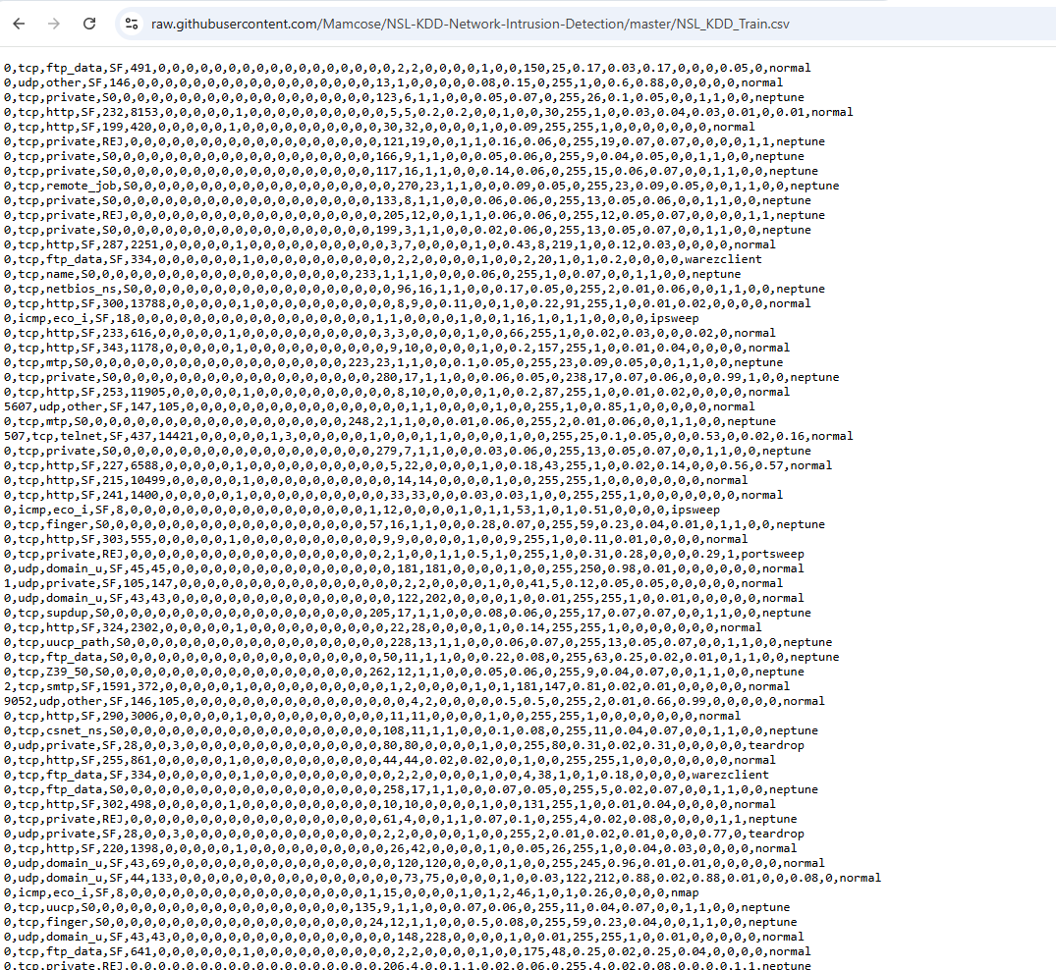
Raw DataSet , Source: NSL-KDD network intrusion benchmark

Slide 4
Ingestion: What We Actually Loaded
Source: NSL-KDD network intrusion benchmark — pulled directly via script, no manual upload. 125,973 rows, 41 raw connection-level features, plus a label.
Sample raw row
duration=0, protocol_type=tcp, service=private, flag=S0, src_bytes=0, dst_bytes=0, count=280, serror_rate=1.00, …, label=neptune
23
4
91.9%
raw attack labels
(e.g. neptune, satan, smurf)
standard categories
DoS / Probe / R2L / U2R
of rows are
normal traffic
Notes:
This is the ingestion step made concrete: pulled the CSV directly via script (no manual download needed), loaded it with pandas, and inspected shape/columns/label distribution before trusting it. Worth mentioning the dataset-quality check here briefly, since it's a real QA habit, not just a dataset-selection footnote.

Slide 5
Normalization: Simulating Fragmented Sources
Single source dataset, grouped into 3 logical buckets to simulate fragmented vendor sources (firewall, endpoint, IDS) — then field-mapped into one standardized schema.
Source A — Connection
Source B — Endpoint
Source C — Traffic Stats
protocol, service, flag
bytes sent / received
failed logins, root shell
compromise indicators
connection counts
error rates
↓ field-mapped into one standardized record
conn_protocol, conn_service, bytes_sent, bytes_received, auth_failed_logins, host_compromise_indicators, conn_error_rate, dst_host_error_rate …
Note: single-source data, simulated as 3 vendor sources — a real Cosmos-scale join across distinct vendor outputs is a harder problem than this prototype solves.
Notes:
Important precision point if asked: there's no real multi-table join happening here, since NSL-KDD is a single CSV -- all 41 fields already live on one row. What I built is the field-mapping/reshaping layer: raw field names get renamed into a standardized schema, and some raw fields get collapsed into derived fields (e.g. host_compromise_indicators = num_compromised + root_shell + su_attempted). I grouped the fields into 3 buckets and framed them as separate vendor sources to demonstrate the *pattern* Cosmos would need at real scale. The harder problem -- actually joining records across distinct vendor outputs with different keys, timestamps, and formats -- is a real gap between this prototype and production. Worth being upfront about that distinction rather than overselling it.

Slide 6
PromptOps: LLM-Generated Threat Narrative
Ground truth withheld from the model — it never sees the label, only the normalized record.
Input (normalized record)
Gemini-generated narrative
flag: S0
bytes_sent: 0 bytes_received: 0
conn_count_same_host: 280
conn_error_rate: 1.0 (100%)
conn_service: private
“This record appears highly suspicious. 280 failed connection attempts to a private service, 100% error rate — suggesting an active scanning attempt or denial-of-service activity.”
Correctly identified — no hallucinated details
ground truth (hidden from LLM): DoS
Notes:
Walk through one real example from the run. This is the differentiator vs a generic QA candidate: testing for hallucination and faithfulness in LLM-generated outputs, not just pass/fail on a deterministic function.

Slide 7
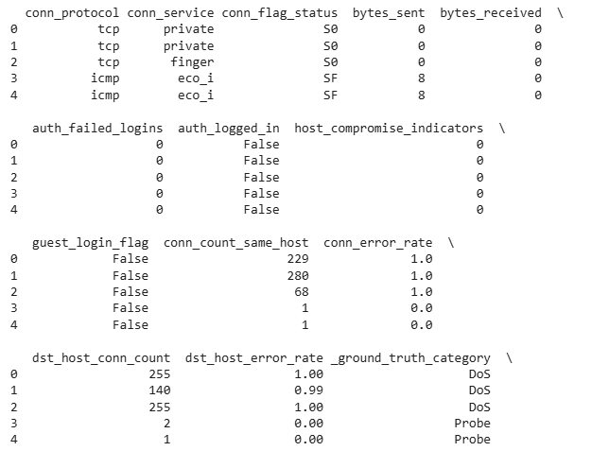
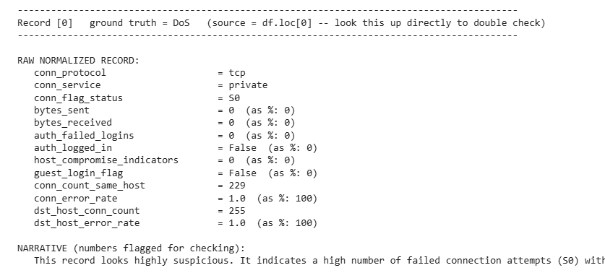
Manual Verification with ground truth

Slide 8

The Validator Itself Had a Bug
My first version flagged 3 correct narratives as FALSE POSITIVES, because it keyword-matched the word “suspicious” — even inside the phrase “does NOT appear suspicious.”
Before fix
After fix
Naive keyword match: any('suspicious' in text) → flags negations as positives → 12/15 “accuracy” (false reading)
Verdict-phrase matching with negation handling → 15/15 correct directional accuracy, true result
Why this matters: a test suite that lies about passing is worse than no test suite — it gives false confidence.
Notes:
This is the strongest slide in the deck. Don't undersell it -- finding and fixing a bug in your OWN validation tooling, mid-build, is a more credible QA signal than a clean demo would have been. Say this explicitly.

Slide 9
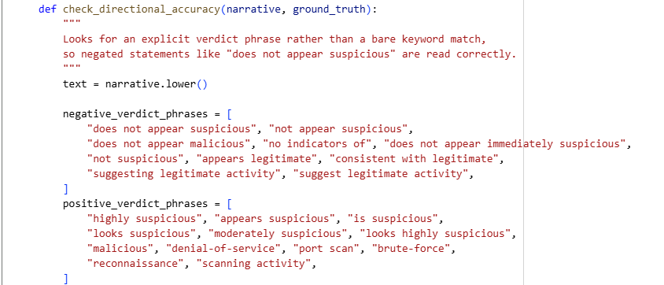
Manual fix for retrieval accuracy

Slide 10
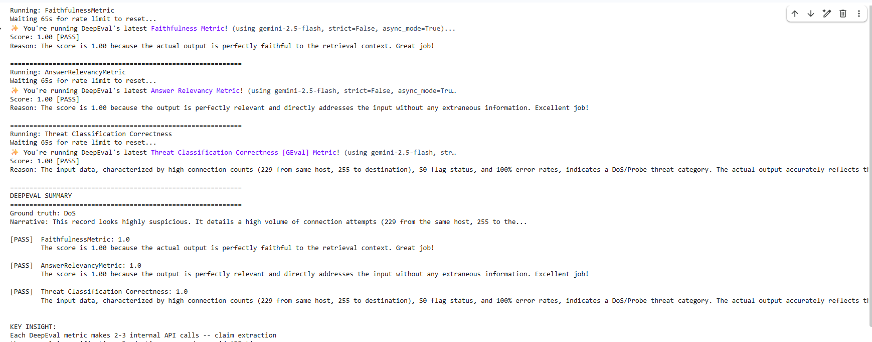
Using DeepEval Framework to evaluate the LLM OUTPUT

